Slide 1
Crowd Science Mapper
Team: Hannah Aker
Sponsors: Dr. Mengyu Qiao and Gail Schmidt
Notes:
Introduction, Team/Client, Project, Deliverables, Sprints, Backlog/User Stories, Requirements & Specifications

Slide 2
Deliverables
Proof-of-concept generic crowd sourcing website
Interface for user to view and report events
Scope does not include mobile applications

Slide 3
User Stories
As a user, I want to be able to view a visual map representation of event reports and a detailed list of event reports.
As a user, I want to be able to register and login and submit an event report.
As a user, I want to be able to select which set of events I would like to view.

Slide 4
Backlog
Navigation Bar
New User Registration
User Login
Event Reporting Interface
Detailed Event List
Map Representation of Events
User Selection of Event Set to View

Slide 5
Requirements and Specifications
This project will be a HTML based webpage using JavaScript JQueries to connect to post to PHP files which will query a Mongo database, and hosted on an Apache server.

Slide 6
Sprints
Sprint 1:
Documentation: Requirements
Review Code from LCM project
Sprint 2:
Documentation: Requirements, Project, Overview, Mission/Elevator
Login and Register
Sprint 3:
Documentation: Project, Overview, Mission/Elevator
Login and Register

Slide 7
Sprints Continued
Sprint 4:
Documentation: Project Revisions
Database Design and Sample Data
Event Set Selection
Sprint 5:
Documentation: Design, Testing, Prototypes
Event Reporting
Detailed Event List
Event Map
Individual Event View
Event Set Picture Carousel

Slide 8
Sprints Continued
Sprint 6 (in progress):
Documentation: Design, Testing, Code Reference Manual, User Documents
Final Project Testing

Slide 9
Architecture, Dataflow, and Communications
Notes:
Architecture, Design, Technical Aspects, Data structures, Dataflow, Communications, Tools

Slide 10
Database Design

Slide 11
Design

Slide 12
Design

Slide 13
Technical Aspects and Tools
Code editing: Notepad++
Remote Desktop Connection
Apache 2.2
Mongo DB 2.4.9

Slide 14
System Integration
Testing
No Unit Testing – Didn’t use IDE with facility for that
Traceability Matrix
No Beta Testing – Would have if time
System is internally integrated. No larger system to be integrated into.
Notes:
Unit or Component Testing, System Testing, System Integration, Remaining backlog, Revised goals and Revised Deliverables

Slide 15
Traceability Matrix
Requirement | Test Case | Result
Each page shall contain a navigation bar at the top of the page. | By Examination | Pass
The navigation bar will have buttons for logging in, new user registration, logout, and event reporting, where appropiate. | By Examination | Pass
The navigation bar shall contain a drop down box for selecting the event set. | By Examination | Pass
The selected event set shall maintain its state when navigating to a different page or refreshing the page. | Select event set on index page, navigate to report page, verify that selection was maintained. Refresh page and verify that selection was maintained. | Pass
Continued in Design Document

Slide 16
Remaining Backlog
Documentation: Design, Testing, File Reference Manual, User Documents (Basic Help Guide)
Final Testing
Minor changes

Slide 17
Project Successes
Project Issues
Jiasong stopped making substantial contributions to the project halfway through Sprint 2, removed from the team prior to the start of Sprint 4
Sprint 4 and 5 went great! Was even able to add some additional features to the project.

Slide 18
Project Revisions
Administration user interface removed from the scope of the project
Minor revisions to documentation with team member removal

Slide 19
Risk Analysis
Because the deliverable is essentially finished and fully functional, very low risk at this point
Risk of loosing a team member
Risk of failing final testing
Risk Mitigation
When Jiasong was removed from the team, the project was revised to account for a missing team member
Any failed test will be immediately fixed, or extensively documented if not fixed.
Notes:
Successes (goals met), Issues or problems (goals not met), Risk Analysis, Risk Mitigation, Timeline, Budget/costs, Intellectual Property Aspects, Licensing

Slide 20
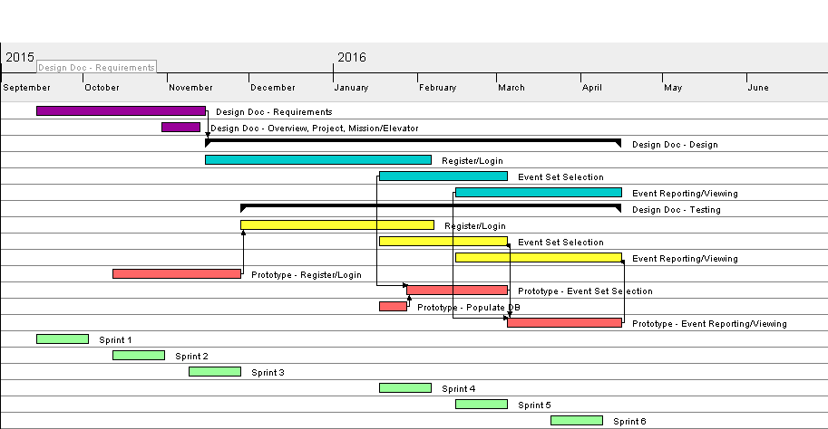
Timeline

Slide 21
Budget/Costs
Server provided by SGT, no other costs
Intellectual Property
Owned by SDSMT
Licensing
Currently not licensed, would fall under an educational license

Slide 22
Prototype Demo
http://52.23.113.55/crowdscience/
Notes:
Prototypes and Demos

